Slide 1
Let’s try it with a pointer example!

Slide 2
Allan Technique Programming Recursively
Decide that the problem needs a recursive solution.
Decide specifically what the procedure will do. What are its inputs and what are its outputs. In a sentence, what does it accomplish?
Restate the problem recursively. Look for instances of the problem you defined in step 2.
If the procedure returns a value, recursive calls to the function must use the returned values and every path through the function must return a value.
Write the procedure using instances of itself. Only worry about a single call of the routine. This is similar to proof by induction. You only solve for one case, but all other cases take care of themselves.
Do not be tempted to follow the recursion. Use the routines having the faith that they will work. If you try to follow the recursion while you are writing the procedure, you will become hopelessly lost. How can you follow the recursion when the recursive routine is not finished yet?
Make sure you take care of the base case stopping the recursion. I like to take care of this last as it is easier to pinpoint the ending conditions after the general case has been written. Some personalities may not be able to delay this decision, but you will find coding is faster if you are able to delay it. It is like delaying the condition on a loop. In all but the simplest of loops, it is easier to write the termination condition after the loop body is written.
Once the routine is written, go ahead and follow the recursion, if you wish.

Slide 3
Let’s try it
Problem: Write a recursive method that inserts an item into an ordered linked list.
1. Decide that the problem needs a recursive solution.
Well, actually it doesn’t cry out to be done recursively, we want a simple problem that shows the steps of recursion – so we’ll do it recursively.

Slide 4
2. Decide specifically what the procedure will do. What are its inputs and what are its outputs. In a sentence, what does it accomplish?
void Insert(Node* curr, int item)

Slide 5
Try it
3. Restate the problem recursively. Look for instances of the problem you defined in step 2.
Be sure to use “insert” in defining “insert”. If you don’t, it isn’t recursive.

Slide 6

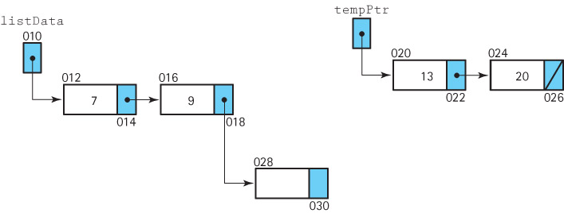
It is helpful to draw yourself a picture

Slide 7
You might say: If the item is less than what you are looking at, place the item here. Otherwise, insert the item in the rest of the list.
Notice how I used “insert” to solve insert.

Slide 8
Try it!
4. Write the procedure using instances of itself. Only worry about a single call of the routine. This is similar to proof by induction. You only solve for one case, but all other cases take care of themselves.

Slide 9
First start…
void Insert(Node* curr, int item)
if (curr->val > item)
curr->next = curr;
AHHH. This makes me nervous. What if curr is NULL? You will die a painful death. Protect yourself.

Slide 10
Second try
void insert(Node* curr, int item)
if (curr==NULL)
curr = new Node(item)
AHHH. This makes me nervous. If you change curr, does it really get changed in the calling routine?

Slide 11
Third try
void insert(Node*& curr, int item)
if (curr==NULL){
curr = new Node(item);
return;}
if (item < curr->next->value)
AHHHH this makes me nervous. What if curr->next is NULL. Yeah – painful death.
But, I said I was going to insert BEFORE the node I’m looking at, so this isn’t needed anyway.

Slide 12
Fourth try
void insert(NodeType*& curr, ItemType item)
if (curr==NULL){
curr = new Node(item);
return;}
if (curr->val > item){
curr= new Node(item,curr); //study this
else
insert(curr->next, item) : //(line R7)
}
Confidence crisis: Does the previous pointer really get pointed to the new node? Let’s trace it on paper. But we need the base case first. You can’t trace something that isn’t written.

Slide 13
Try it!
5. Make sure you take care of the base case stopping the recursion. I like to take care of this last as it is easier to pinpoint the ending conditions after the general case has been written.
What is the base case for our code? When do you stop executing? Notice our “nervous” approach (never following a null pointer) served us well as a base case. If the list was empty (or we fell off the list), we already have that covered.

Slide 14
Now go ahead and trace it
6. Once the routine is written, go ahead and follow the recursion, if you wish.
How does recursion work?
What has to be stored as I enter each call?
Let’s look at insert(listData,11);

Slide 15
Run time stack. Items in red are not actually stored.
curr | item | returnAddr | Value in the current node
10 | 11 | Main | 7

Slide 16
Can you see how the link from the node containing 9 gets set?

Slide 17
curr | item | returnAddr | Value in the current node
14 | 11 | R7 | 9
10 | 11 | Main | 7
void insert(NodeType*& curr, ItemType item)
if (curr==NULL){
curr = new Node(item);
return;}
if (curr->val > item){
curr= new Node(item,curr);
else
insert(curr->next, item) //(line R7)

Slide 18
Can you see how the link from the node containing 9 gets set?

Slide 19
curr | item | returnAddr
18 | 11 | R7 | 13
14 | 11 | R7 | 9
10 | 11 | Main | 7
void insert(NodeType*& curr, ItemType item)
if (curr==NULL){
curr = new Node(item);
return;}
if (curr->val > item){
curr= new Node(item,curr);
else
insert(curr->next, item) //(line R7)

Slide 20
Be sure to consider the special cases
Insert before first node
Insert into empty list
Insert at end of list.
Did we get them all covered?

